Slide 1

Project 2: Karamoja Region Productivity Report
Presented by : Pauline Mueni

Slide 2

Business Understanding
Karamoja is a region in Uganda facing Food insecurity.
Reasons for food insecurity :
Low production due to intense droughts.
Low production due to Pest and disease outbreaks.
Lack of proper visibility in the state of the region by NGO's and reliance on inadequate information to prioritize help.
Business Need: Visibility of the overall state of the Karamoja Region.

Slide 3
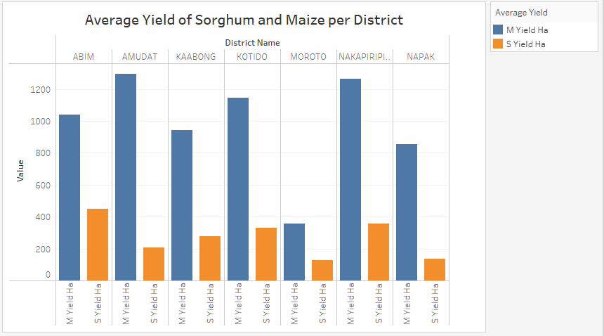
Research Objective 1: Top 2 district with the lowest sorghum and maize average yield in Karamoja district

Slide 4
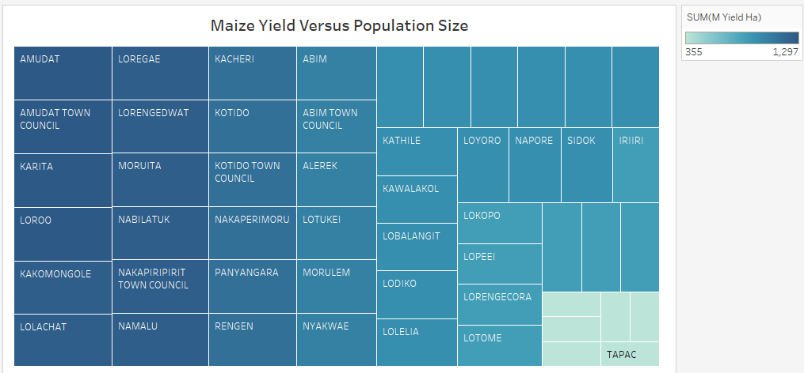
Research Objective 2: To find the bottom 6 subcounties have the lowest maize yields relative to their population size.

Slide 5
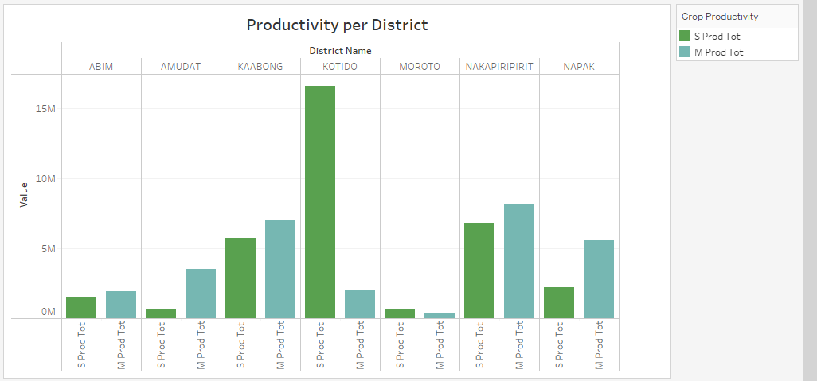
Research Objective 3: To find out the top 2 district with the lowest productivity of maize and sorghum.

Slide 6
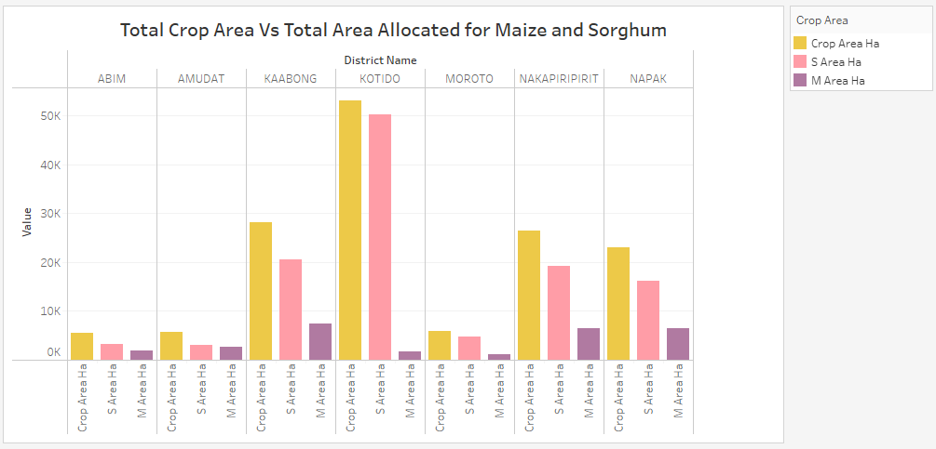
Research Question 4: To find out the district with the highest crop area allocation for sorghum and maize in Karamoja

Slide 7
Conclusion and Recommendations
Moroto has the most food shortage due to low crop area allocation and low productivity and low average crop yields for both sorghum and Maize. as a result, Moroto should be considered a priority for support by the NGO’s.
Future region planning should access the major cause of low productivity in Moroto such as pest outbreak and draught intensity to help increase the subcounty yield.
Compared to the crop area available, sorghum has the largest crop allocation compared to maize. however, the average production and total yield of sorghum is less than that of maize. As such, the NGO's can advice farmers to revise the crop allocation to ensure high average yields in the area.

Slide 8

Thank you for your time and attention.

Slide 9

Question and Answer Session

